Slide 1
Linear Algebra
Lecture 45

Slide 2
Revision
Lecture III

Slide 3
Matrix Algebra
Vector Spaces
and Sum-up

Slide 4
Matrix Algebra
Matrix Operations
Inverse of a Matrix
Characteristics of Invertible Matrices
…

Slide 5
Continued
Partitioned Matrices
Matrix factorization
Iterative Solutions of linear Systems

Slide 6
Vector Spaces
Vector Spaces and Subspaces
Null Spaces, Column Spaces and Lin Tr.
Lin Ind. Sets: Bases
…

Slide 7
Continued
Coordinate Systems
Dim. of a Vector Spaces
Rank
Change of Basis
Application to Diff Eq.

Slide 8
Definition
Let V be an arbitrary nonempty set of objects on which two operations are defined, addition and multiplication by scalars.

Slide 9
If the following axioms are satisfied by all objects u, v, w in V and all scalars l and m, then we call V a vector space.

Slide 10
Axioms of Vector Space
For any set of vectors u, v, w in V and scalars l, m, n:
1. u + v is in V
2. u + v = v + u

Slide 11
3. u + (v + w) = (u + v) + w
4. There exist a zero vector 0 such that
0 + u = u + 0 = u
5. There exist a vector –u in V such that
-u + u = 0 = u + (-u)

Slide 12
6. (l u) is in V
7. l (u + v)= l u + l v
8. m (n u) = (m n) u = n (m u)
9. (l + m) u = I u +m u
10. 1u = u where 1 is the multiplicative identity

Slide 13
Definition
A subset W of a vector space V is called a subspace of V if W itself is a vector space under the addition and scalar multiplication defined on V.

Slide 14
Theorem
If W is a set of one or more vectors from a vector space V, then W is subspace of V if and only if the following conditions hold:

Slide 15
Continue!
(a) If u and v are vectors in W, then u + v is in W
(b) If k is any scalar and u is any vector in W, then k u is in W.

Slide 16
Definition
The null space of an m x n matrix A (Nul A) is the set of all solutions of the hom equation Ax = 0
Nul A = {x: x is in R^{n} and Ax = 0}

Slide 17
Definition
The column space of an m x n matrix A (Col A) is the set of all linear combinations of the columns of A.

Slide 18
Theorem
The column space of a matrix A is a subspace of R^{m}.

Slide 19
Theorem
A system of linear equations Ax = b is consistent if and only if b is in the column space of A.

Slide 20
Definition
A linear transformation T from V into W is a rule that assigns to each vector x in V a unique vector T (x) in W, such that

Slide 21
Cont....
(i) T (u + v) = T (u) + T (v) for all u, v in V, and
(ii) T (cu) = c T (u) for all u in V and all scalars c

Slide 22
Definition
The kernel (or null space) of such a T is the set of all u in V such that T (u) = 0.

Slide 23

Definition
An indexed set of vectors {v₁,…, v_{p}} in V is said to be linearly independent if the vector equation
has only the trivial solution,
c₁=0, c₂=0,…,c_{p}=0

Slide 24
Definition
The set {v₁,…,v_{p}} is said to be linearly dependent if (1) has a nontrivial solution, that is, if there are some weights, c₁,…,c_{p}, not all zero, such that (1) holds. In such a case, (1) is called a linear dependence relation among v₁, … , v_{p}.

Slide 25

Spanning Set Theorem
Let S = {v₁, … , v_{p}} be a set in V and let H = Span {v₁, …, v_{p}}.
(a) If one of the vectors in S, say v_{k}, is a linear combination of the remaining vectors in S, then the set formed from S by removing v_{k} still spans H.
(b) If H {0}, some subset of S is a basis for H.

Slide 26
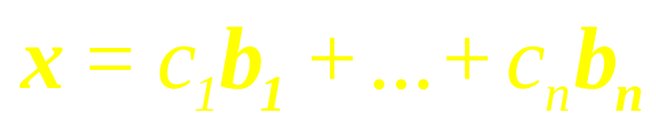
Definition
Suppose the set B = {b₁, …, b_{n}} is a basis for V and x is in V. The coordinates of x relative to the basis B (or the B-coordinates of x) are the weights c₁, … , c_{n} such that
…

Slide 27
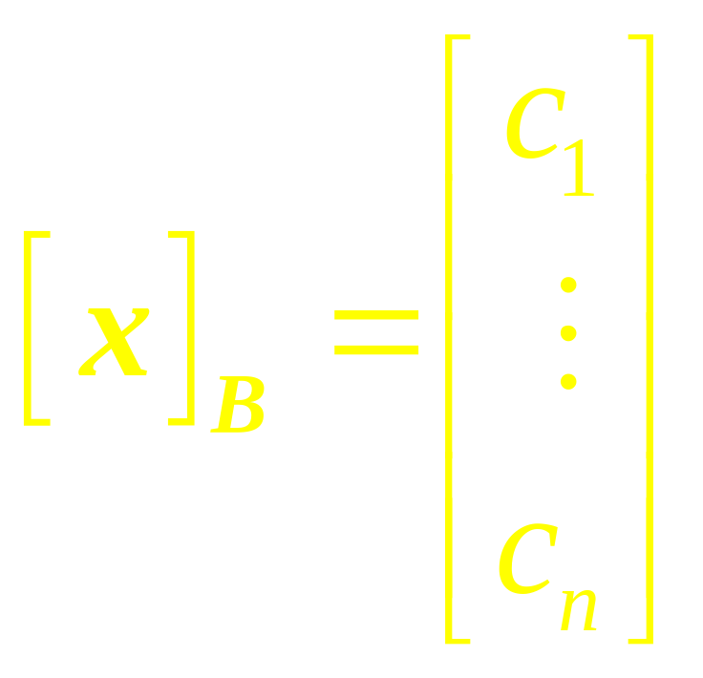
If c₁,c₂,…,c_{n} are the B-Coordinates of x, then the vector in R^{n}
is the coordinate of x (relative to B) or the B-coordinate vector of x. The mapping x → [x]_{B} is the coordinate mapping (determined by B)

Slide 28
Definition
If V is spanned by a finite set, then V is said to be finite-dimensional, and the dimension of V, written as dim V, is the number of vectors in a basis for V.
…

Slide 29
Continue!
The dimension of the zero vector space {0} is defined to be zero.
If V is not spanned by a finite set, then V is said to be infinite-dimensional.

Slide 30
Theorem
The pivot columns of a matrix A form a basis for Col A.

Slide 31
The Basis Theorem
Let V be a p-dimensional vector space, p> 1. Any linearly independent set of exactly p elements in V is automatically a basis for V. Any set of exactly p elements that spans V is automatically a basis for V.

Slide 32
The Dimensions of
Nul A and Col A
The dimension of Nul A is the number of free variables in the equation Ax = 0.
The dimension of Col A is the number of pivot columns in A

Slide 33
Definition
The rank of A is the dimension of the column space of A. Since Row A is the same as Col A^{T}, the dimension of the row space of A is the rank of A^{T}. The dimension of the null space is sometimes called the nullity of A.

Slide 34
The Rank Theorem
The dimensions of the column space and the row space of an m x n matrix A are equal. This common dimension, the rank of A, also equals the number of pivot positions in A and satisfies the equation
rank A + dim Nul A = n

Slide 35
Theorem
If A is an m x n, matrix, then
(a) rank (A) = the number of leading variables in the solution of Ax = 0
(b) nullity (A) = the number of parameters in the general solution of Ax = 0

Slide 36
Theorem
If A is any matrix, then
rank (A) = rank (A^{T})

Slide 37
Four Fundamental
Matrix Spaces
Row space of A
Column space of A
Null space of A
Null space of A^{T}

Slide 38
The Invertible Matrix Theorem
Let A be an n x n matrix. Then the following statements are each equivalent to the statement that A is an invertible matrix. …

Slide 39
The columns of A form a basis of R^{n}.
Col A = R^{n}
dim Col A = n
rank A = n
Nul A = {0}
dim Nul A = 0

Slide 40
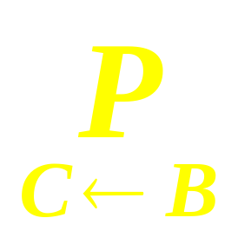
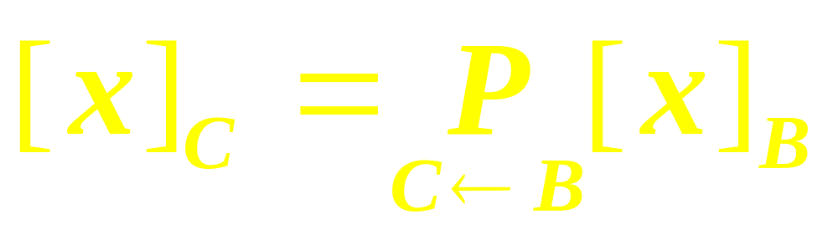
Theorem
Let B = {b₁, … , b_{n}} and
C = {c₁, … , c_{n}} be bases of a vector space V. Then there is an n x n matrix such that
…

Slide 41
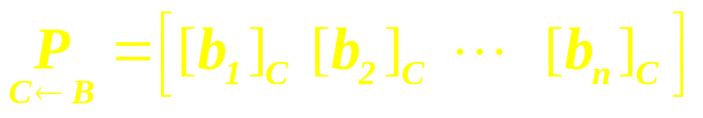
Continue!
The columns of
are the C-coordinate vectors
of the vectors in the basis B.
That is,
…

Slide 42
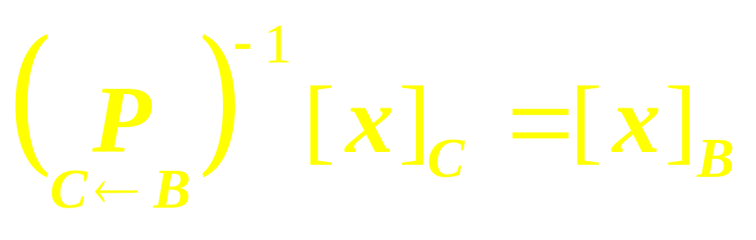
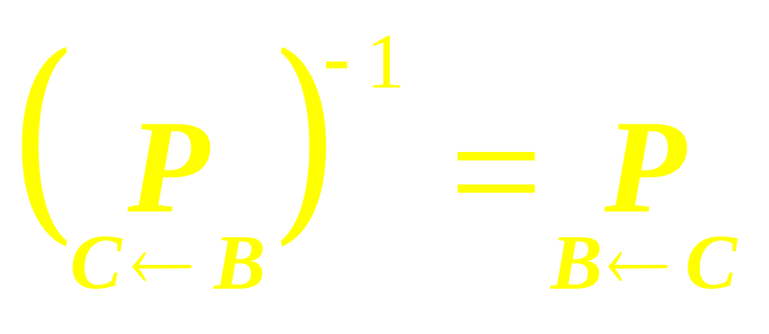
Observe

Slide 43
Definition
Given scalars a₀, … , a_{n}, with a₀ and a_{n} nonzero, and given a signal {z_{k}}, the equation
is called a linear difference equation (or linear recurrence relation) of order n. …

Slide 44
Continue!
For simplicity, a₀ is often taken equal to 1. If {z_{k}} is the zero sequence, the equation is homogeneous; otherwise, the equation is non-homogeneous.

Slide 45

Theorem
If a_{n} 0 and if {z_{k}} is given, the equation
y_{k+n}+a₁y_{k+n-1}+…+a_{n-1}y_{k+1}+a_{n}y_{k}=z_{k},
for all k has a unique solution whenever y₀,…, y_{n-1} are specified.

Slide 46
Theorem
The set H of all solutions of the nth-order homogeneous linear difference equation
y_{k+n}+a₁y_{k+n-1}+…+a_{n-1}y_{k+1}+a_{n}y_{k}=0,
for all k is an n-dimensional vector space.

Slide 47
Reduction to Systems of First-Order Equations
A modern way to study a homogeneous nth-order linear difference equation is to replace it by an equivalent system of first order difference equations, …

Slide 48
Continue!
written in the form
x_{k+1} = Ax_{k} for k = 0, 1, 2, …
Where the vectors x_{k} are in R^{n} and A is an n x n matrix.

Slide 49
Linear Algebra
Lecture 45

Slide 50
Linear Algebra
Completes
Thank You

